Slide 1
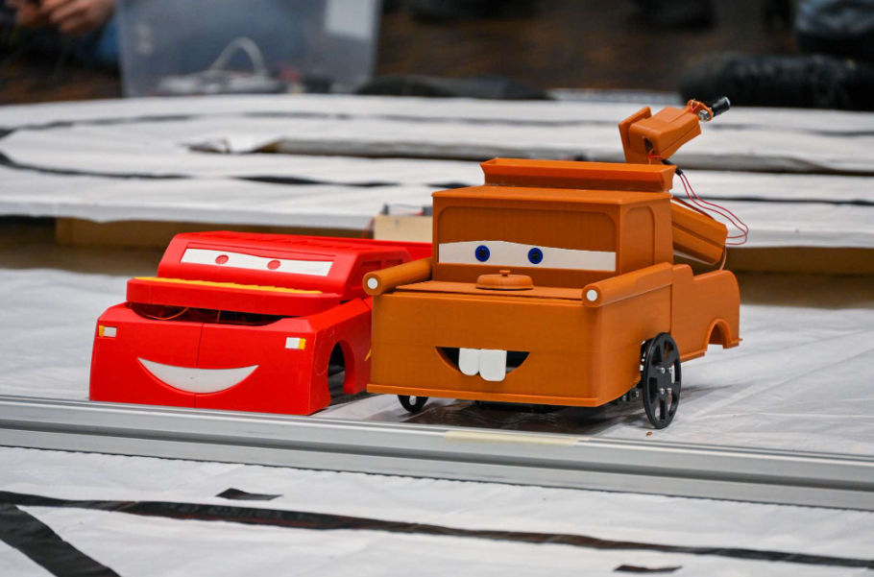
Semesterproject
Alex, Karl, Lukas, Magne, Nikolai og Rasmus
Notes:
Karl

Slide 2
Introduction and problem statement
Track Driving: The fastest and/or highest number of laps completed on a predetermined track within a specific time frame. The control of the mobile robot must be autonomous.
Logistics Management: Collecting the highest number of items within a specific time frame. The control of the mobile robot must be autonomous.
Pimp My Ride: Decorating your mobile robot with creative, unique, and functional designs, including costumes, lights, and sounds.
Notes:
Nikolai

Slide 3
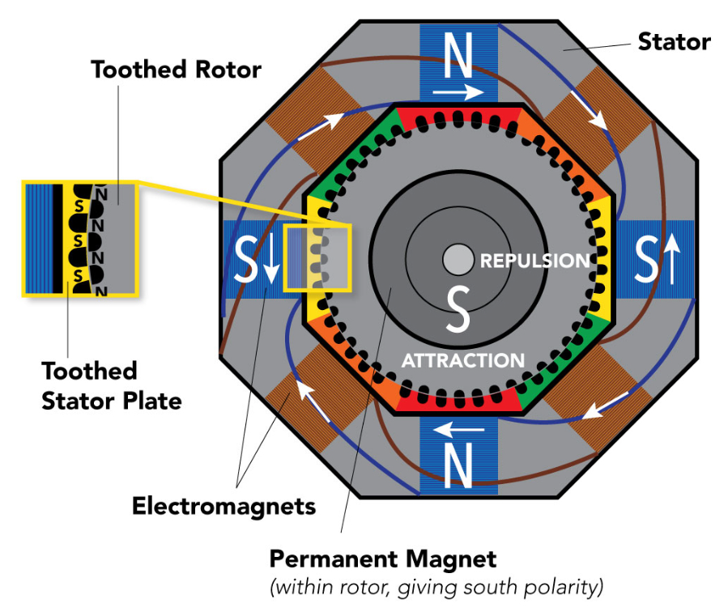
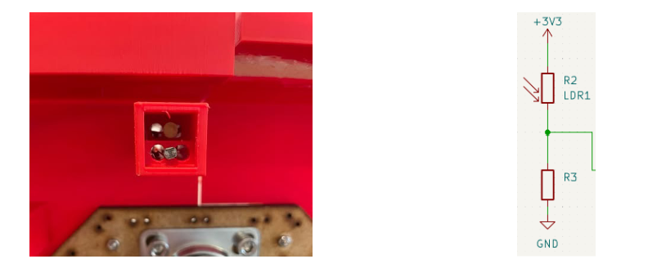
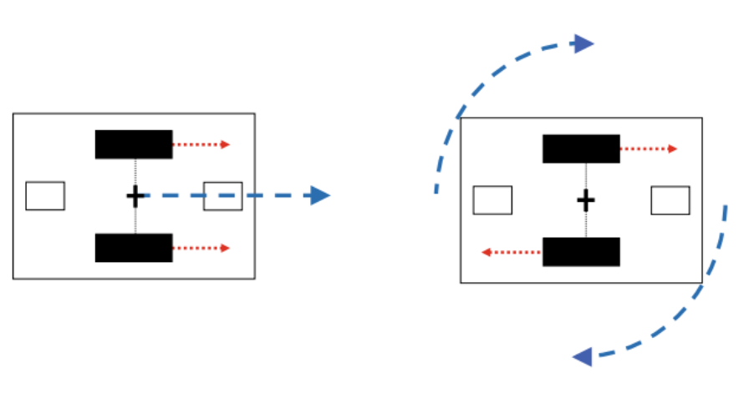
Robotic fundamentals
Stepper motor
LDR-sensor
Differential drive
Picture: Differentialdriver, https://link-springer-com.proxy1-bib.sdu.dk/book/10.1007/978-981-16-0804-9
Picture: Stepper motor, https://www.clippard.com/cms/wiki/how-stepper-motors-provide-precision-control
Notes:
Magne

Slide 4
Racecar
Goal: Consistently drive around a track as fast as possible.
Get the highest steps per second while following a black line.
Using synchronous code flow
Lowering delay between steps
Increasing duty cycle for more torque
Consistently collect data using light dependent resistors.
Comparator
Flip-flop
Notes:
Lukas

Slide 5
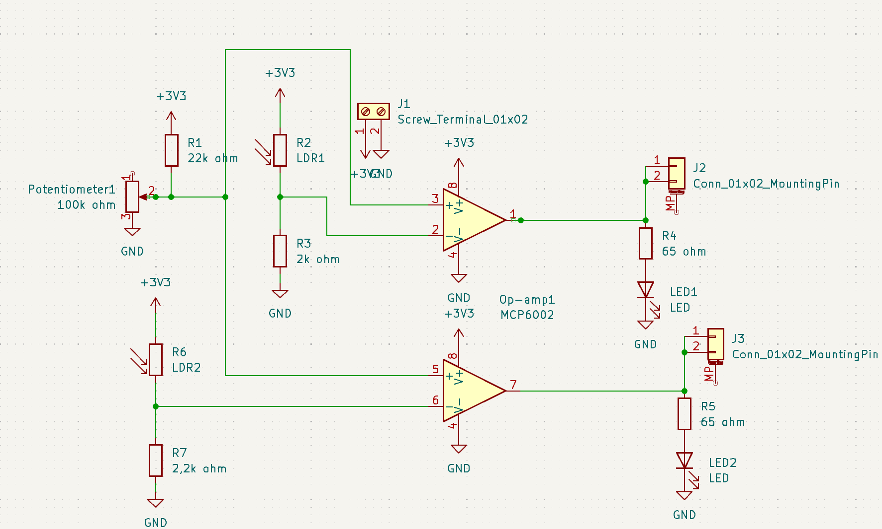
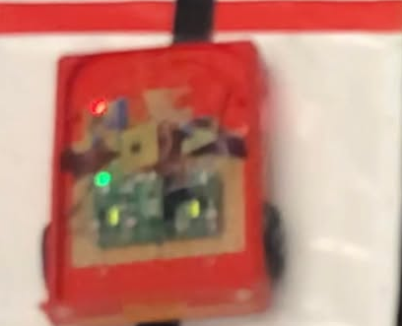


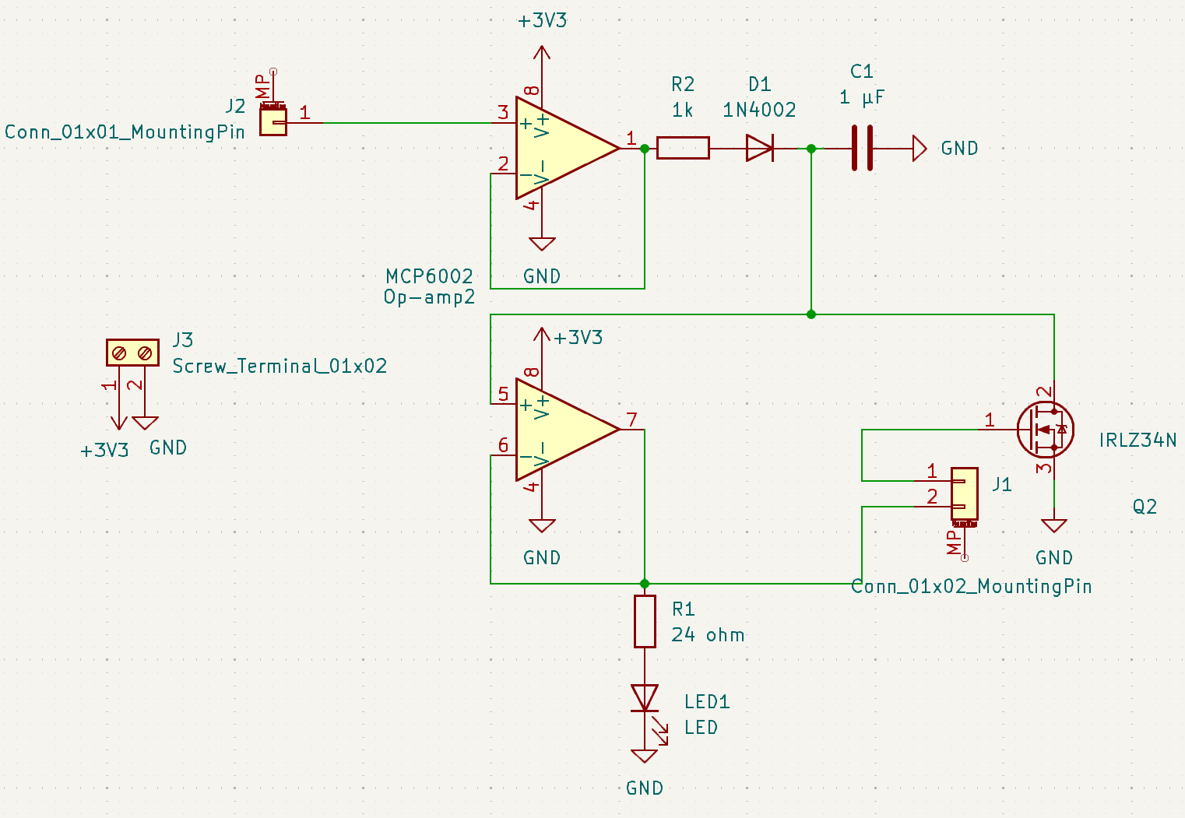
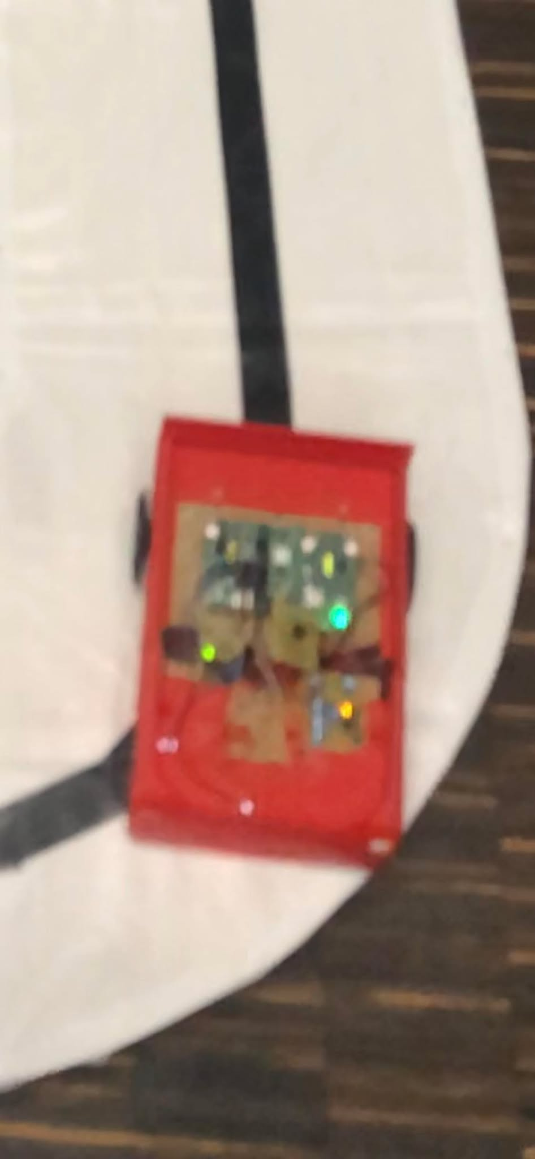
Comparator and flip-flop
Notes:
Alex

Slide 6
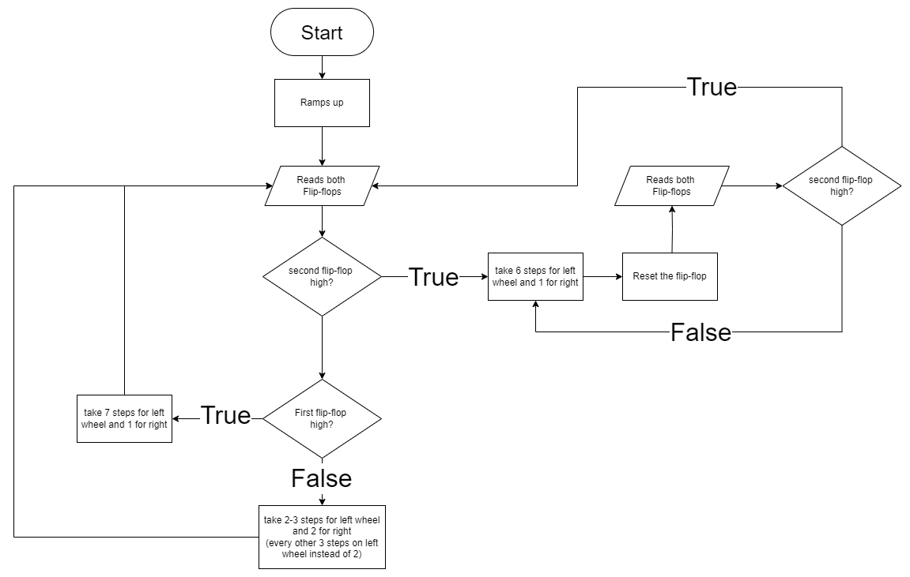
Driving logic
Notes:
Lukas

Slide 7
Logistics car
Goal: Collect all the nuts within the timeframe
Using dead reckoning
Crane for more accuracy
Electromagnet for collecting the nuts
Making the high value nuts easier to collect
Solution
Notes:
Rasmus

Slide 8
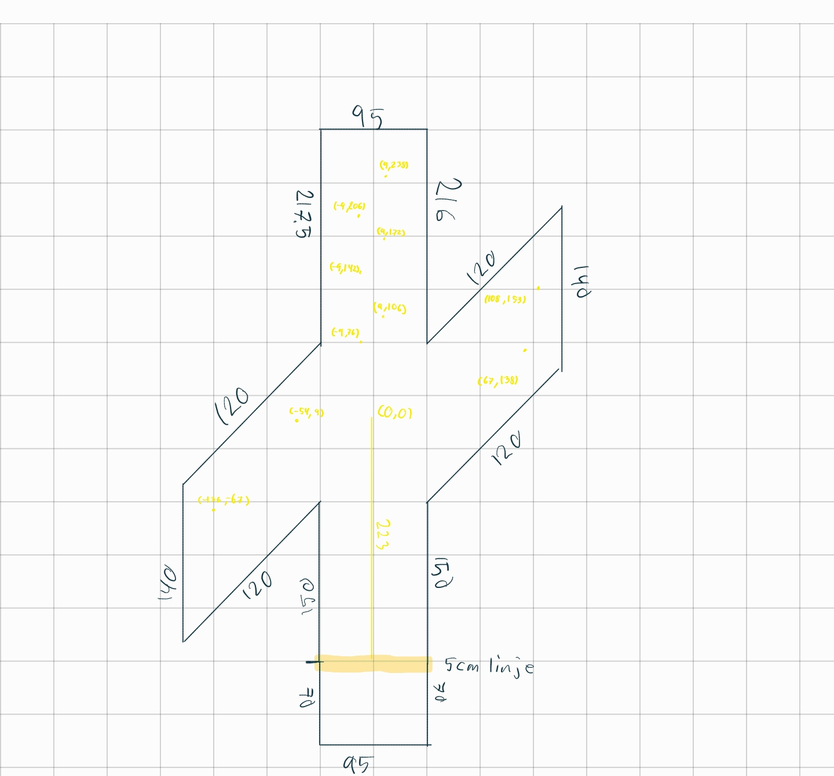
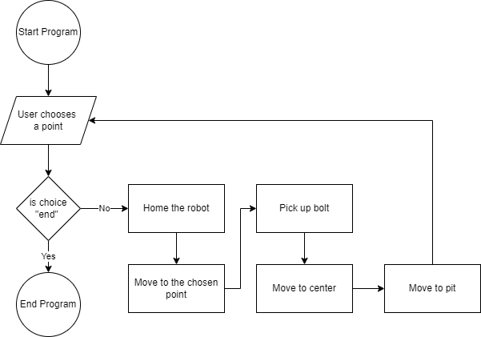
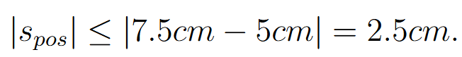
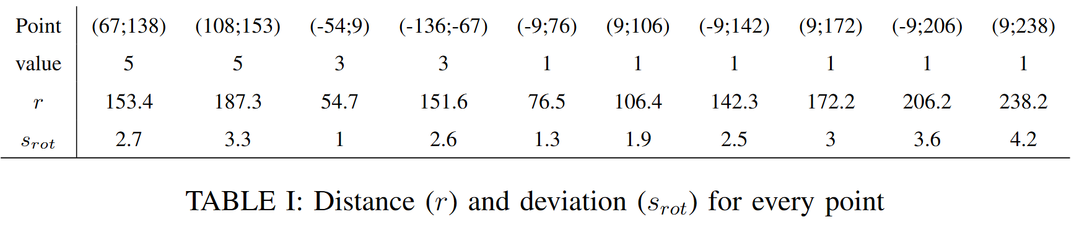
Navigation
Notes:
Magne

Slide 9
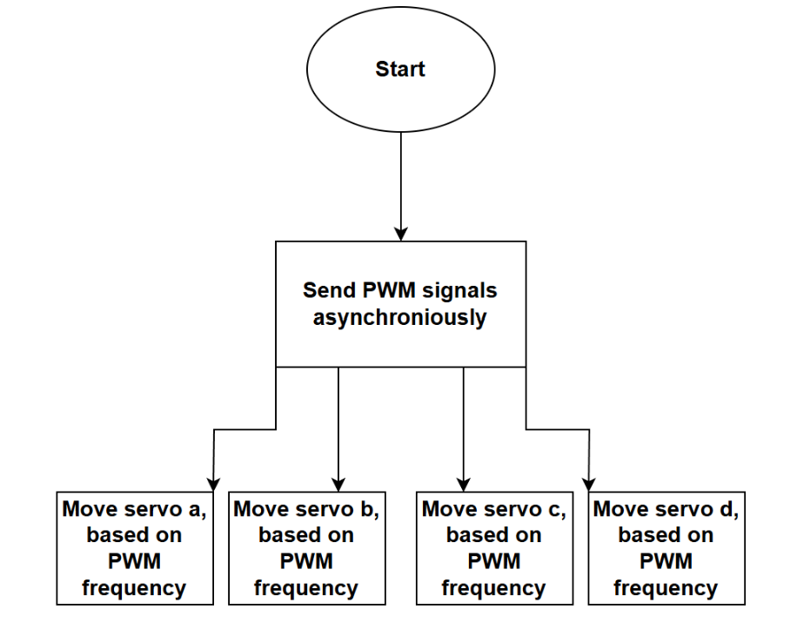
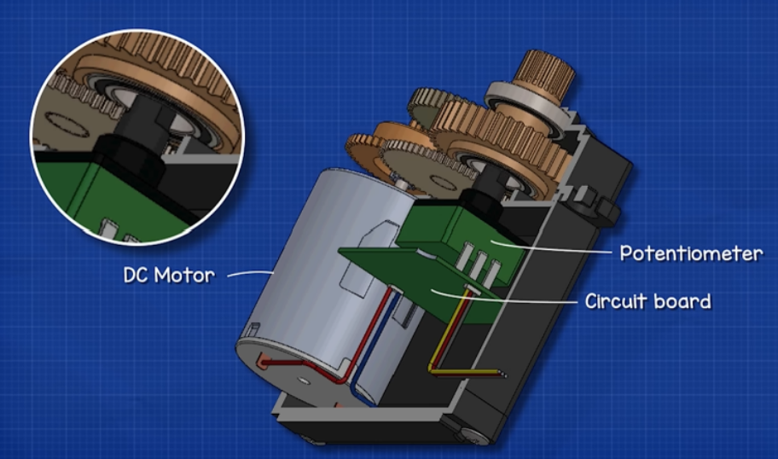
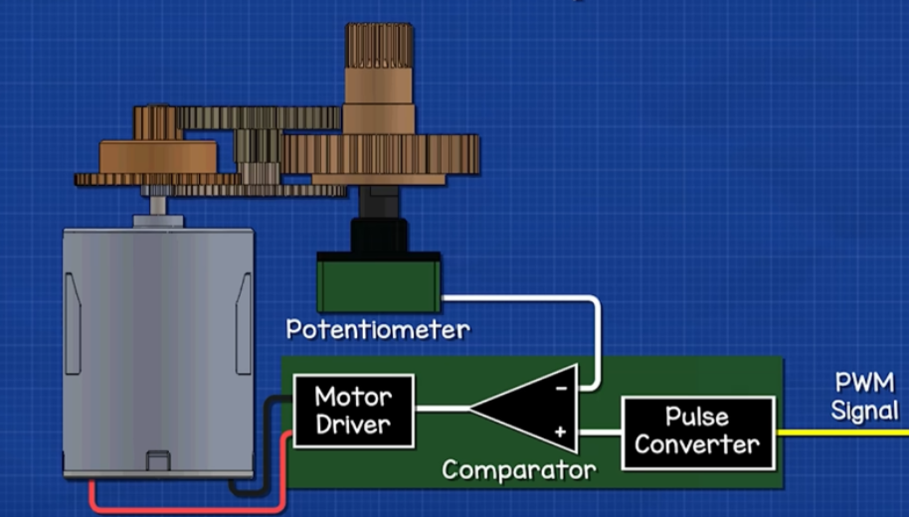
Crane
Inside the servomotor
Correcting for inaccuracies in navigation
Asynchronous and complete crane functionality
Servomotor pictures: https://www.youtube.com/watch?v=1WnGv-DPexc&t=571s
Notes:
Karl

Slide 10
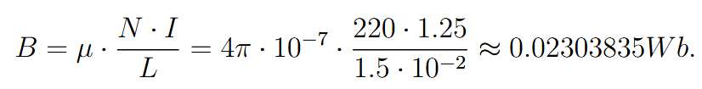
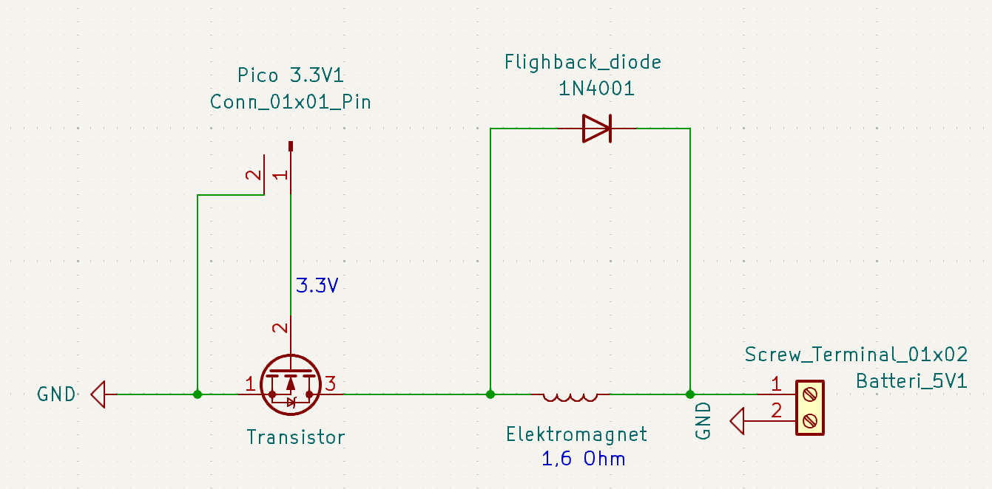
Electromagnet
Magnetic field strength
Notes:
Niko og Rasmus

Slide 11
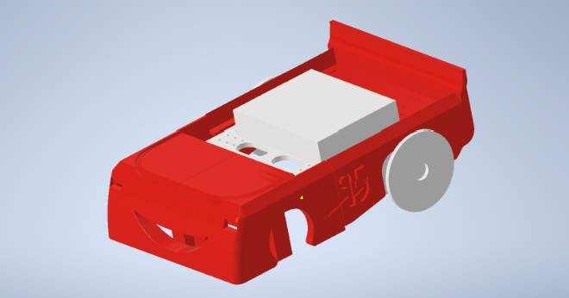
Pimp my ride
3D printet
FireMcKing and Humle
Crane and LDR functionallity
Modelled in autodesk inventor
Notes:
Karl

Slide 12
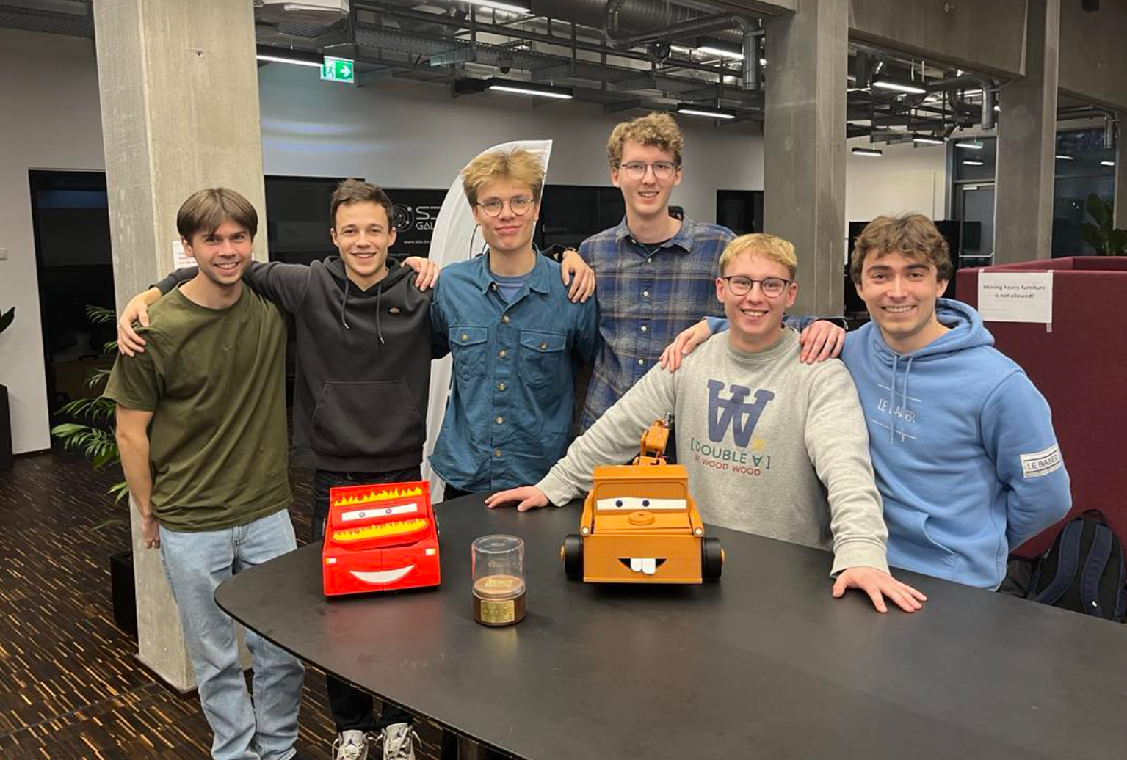
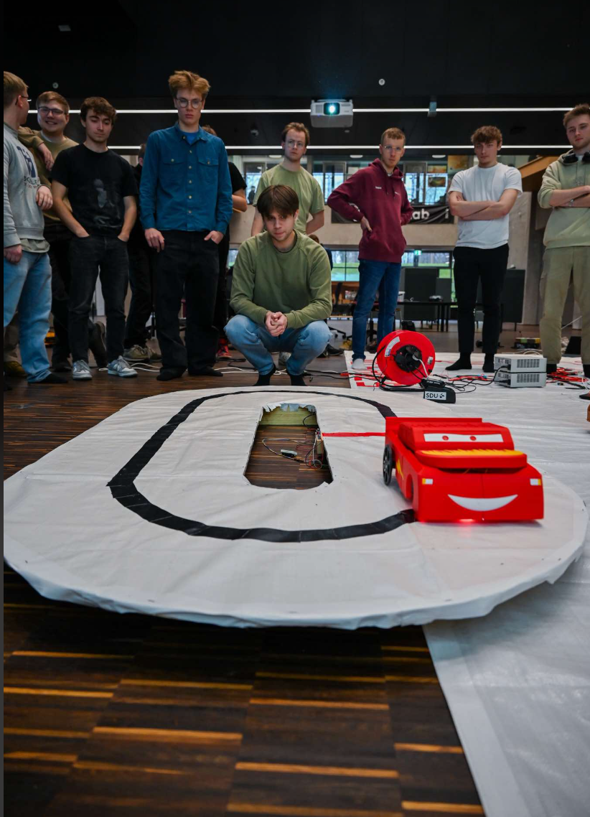
Competition
Collecting nuts
Work in action
Laps driven
Notes:
Alex for racecar og Rasmus

Slide 13
Discussion
Inaccuracies
Navigation
Crane
Op-amp in flip-flop
Sensor placement
Notes:
Lukas og Karl (måske magne idk)

Slide 14
Conclusion
Flip-flop
Trial and error
Dead reckockning
Crane
Electromagnet
Notes:
Nikolai

Slide 15
Group dynamic
Agreements
Distrubution of tasks
Catch up
Notes:
Alex

Slide 16

Learning outcome
Working in larger groups
Interdisciplinarity
Notes:
Magne

